Slide 1

WELD 94: 20th June 2022
STABILITY ANALYSIS OF LEGGED ROBOT
UNDER EXTERNAL DISTURBANCE
ALINJAR DAN
Supervisors
PROF. S. K. SAHA
PROF. RAMA KRISHNA K
Department of Mechanical Engineering, IIT Delhi
SANIYA PATWARDHAN
Department of Mechanical Engineering, IIT Gandhinagar

Slide 2
Presentation Outline
1. Dynamic stability Analysis of Legged Robots
Problem and Brief Overview
Brief Literature review
Flow chart of work
Optimal Control Architecture
Result and Discussion for Biped
Result and Discussion for Quadruped (Simulink)
Conclusion

Slide 3
Dynamic Stability Analysis

Slide 4
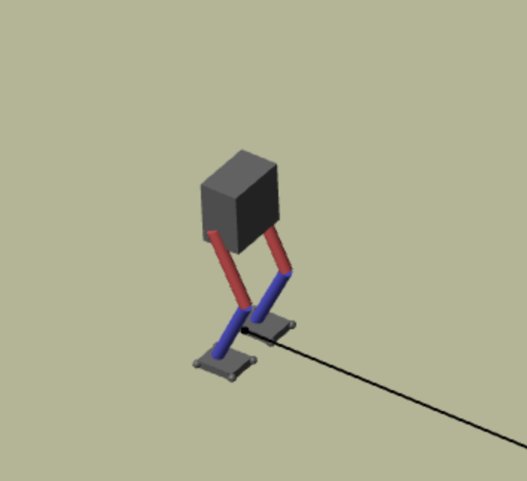
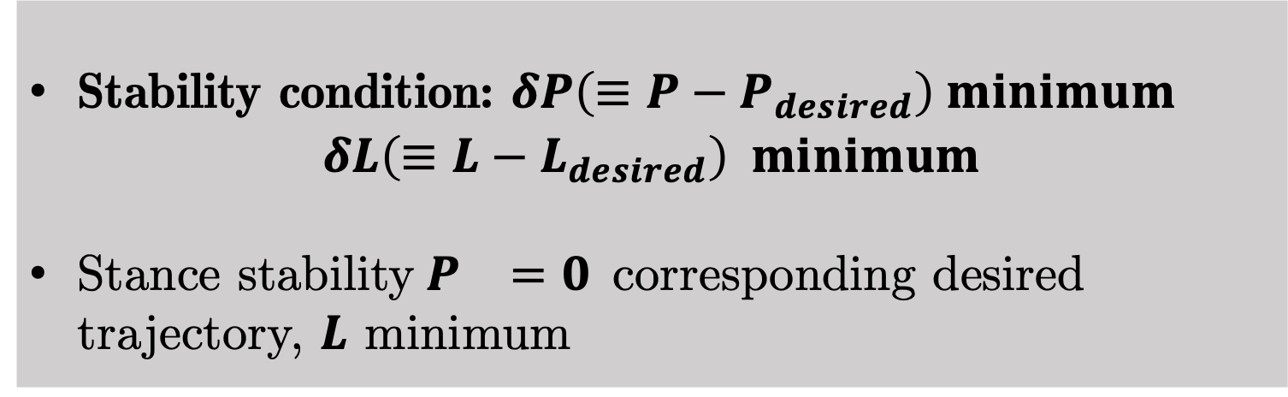
Dynamic Stability: Problem and Brief Overview
Problem : Balance Stability of biped upon large continuous external disturbance
Centroidal dynamics utilized for stability under large and continuous disturbance (motivation: Orin et al. 2013)
Centroidal Dynamics: Dynamics through linear and angular momentum of the system at Centre of Gravity (CG)
Centre of gravity
Angular
momentum
Linear momentum
Stability condition: $δP\left(≡P−P_{desired}\right) minimum$
$$δL\left(≡L−L_{desired}\right) minimum$$
Stance stability $P_{}=0$corresponding desired trajectory, $L$ minimum
Centroidal Dynamics: Biped
Orin, David E., Ambarish Goswami, and Sung-Hee Lee. "Centroidal dynamics of a humanoid robot." Autonomous robots 35.2 (2013): 161-176

Slide 5
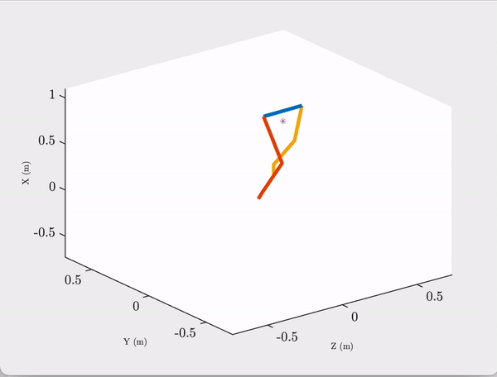
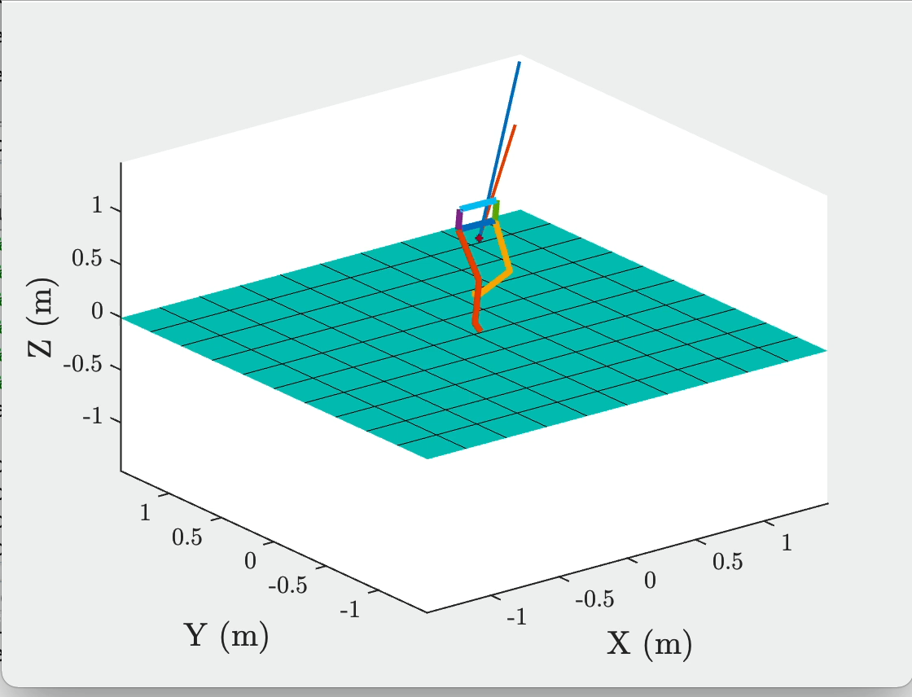
Dynamic Stability: Problem Demonstration
Biped Falling under Horizontal push
Biped Falling under Vertical push

Slide 6
Dynamics Stability: Brief Literature Review
Relevant literature and their limitations
Author and year | Novel Contribution | Limitation
Machietto et al. (2009) | Balance in terms of CG and ZMP (Zero Moment Point) | Tested for impulsive force only (Magnitude or duration not mentioned)
Orin et al. (2012) | Controller for humanoid robots on non-level ground | Can’t accommodate no-slip condition, trunk rotation with desired momenta: fails for large or continuous push
Henze et al. (2019) | Whole body control for multi contact scenario | Tested for Impulse (like kick) only (Magnitude or duration not mentioned)
Bhaskar et al. (2021) | Adaptive Artificial Time Delay Control rejecting impulse during walking | Tested for push of 10 N only Contact points more than two: Inherently Convenient for stability
Summary: Stability against large continuous push (magnitude and duration) is challenging
Macchietto, Adriano, Victor Zordan, and Christian R. Shelton. "Momentum control for balance." ACM SIGGRAPH 2009 papers. 2009.1-8.
Orin, David E., Ambarish Goswami, and Sung-Hee Lee. "Centroidal dynamics of a humanoid robot." Autonomous robots 35.2 (2013):161-176

Slide 7
Dynamic Stability: Flow chart of work
Minimum Trunk rotation, Angular Momentum
Centroidal Dynamics
Stability conditions
at CG
Optimal control
Actuator Commands
Actuator Limits
No slip Friction, Positive Reaction force condition command
Flow chart of work in Dynamic stability of biped under large disturbance
Controller does not have any information on the external disturbance being applied

Slide 8
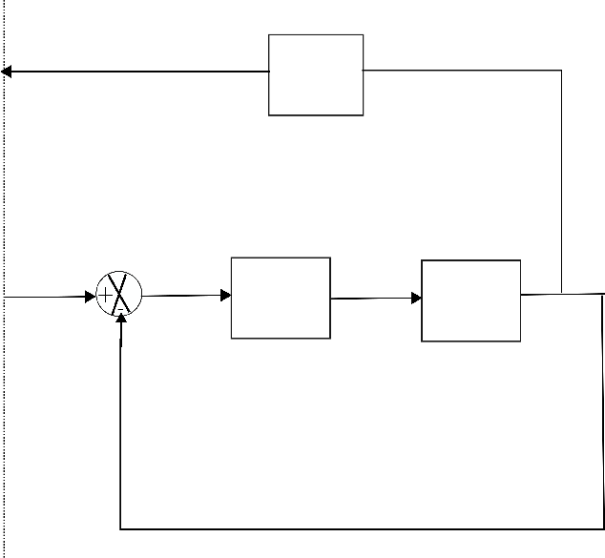
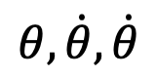
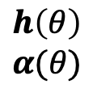
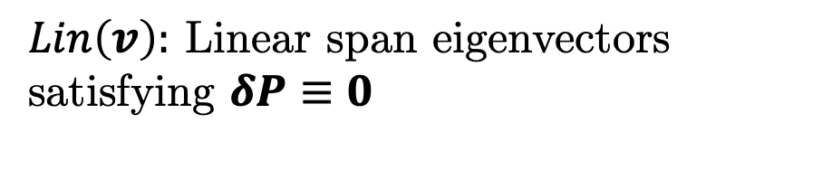
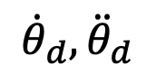
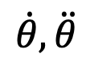
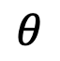
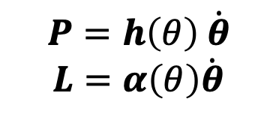
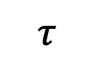
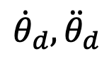
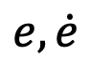
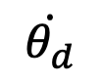
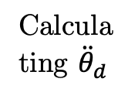
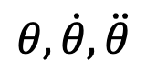
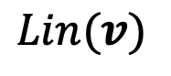
Dynamic Stability: Optimal Control Architecture
$$P=h\left(θ\right) \dot{θ}$$
$L=α\left(θ\right)\dot{θ}$
Internal
Optimization
$$θ, \dot{θ}, \dot{θ}$$
$$h\left(θ\right)$$
$$α(θ)$$
$$Lin(v)$$
$$θ$$
Eigen
analysis
Optimization
Robot
Inputs
$$e, \dot{e}$$
$$\dot{θ_{d}}$$
Computed
Torque control
$$τ$$
$${\dot{θ}}_{d},{\ddot{θ}}_{d}$$
Robot
$$θ, \dot{θ}, \ddot{θ}$$
Calculating ${\ddot{θ}}_{d}$
$$\dot{θ}, \ddot{θ}$$
$${\dot{θ}}_{d},{\ddot{θ}}_{d}$$
Internal Optimization
$Lin\left(v\right):$ Linear span eigenvectors satisfying $δP≡0$
Control Architecture
Optimization: Weightage of joint velocities. cost function ensures no-slip, minimal trunk rotation, minimum angular momentum etc

Slide 9
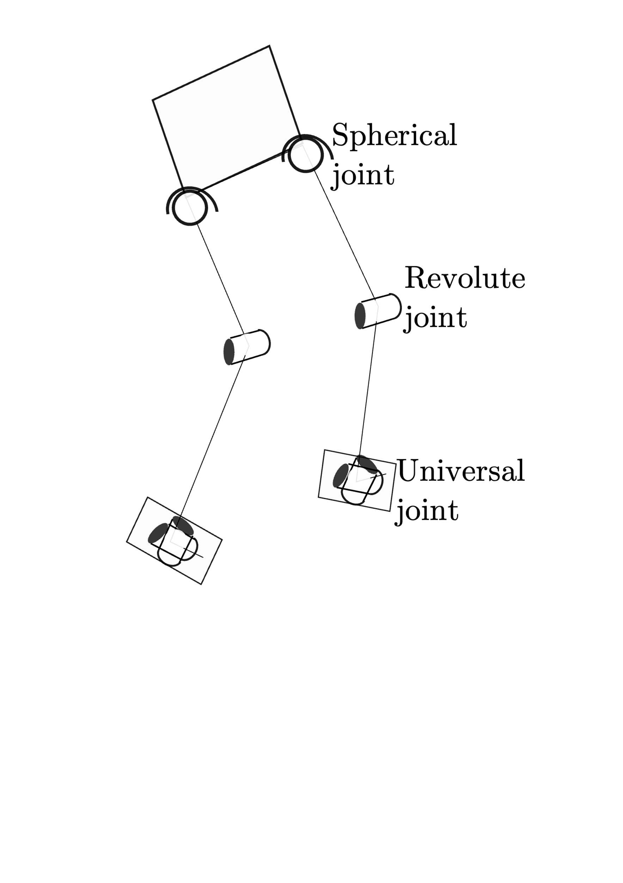
Dynamic Stability: Kinematic Architecture of Biped and no controller simulation
Biped: Kinematic Architecture
Spatial Biped: 12 DOF
Mechanical joint constraints: maintained (as per https://www.physio-pedia.com/Range_of_Motion)

Slide 10

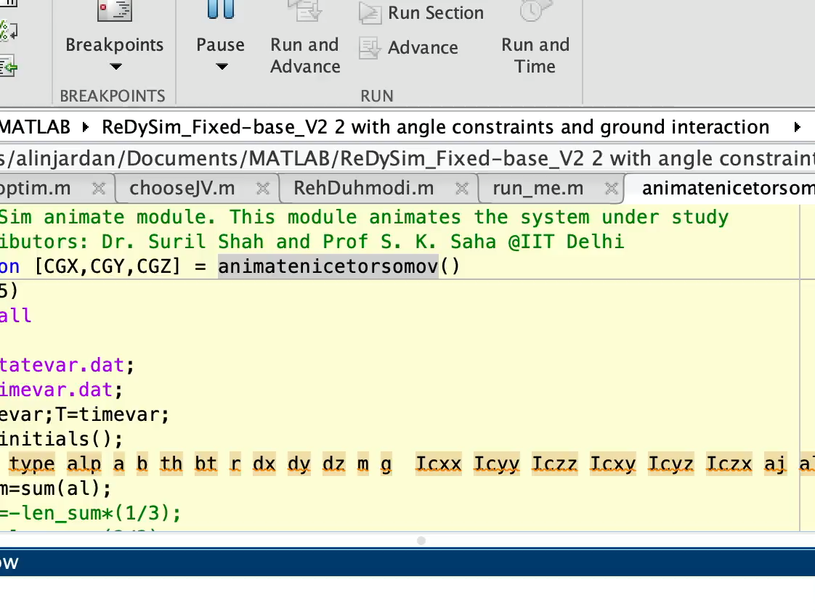
Dynamic Stability: Failed Simulations
No No-slip condition
No Minimum Angular momentum condition

Slide 11
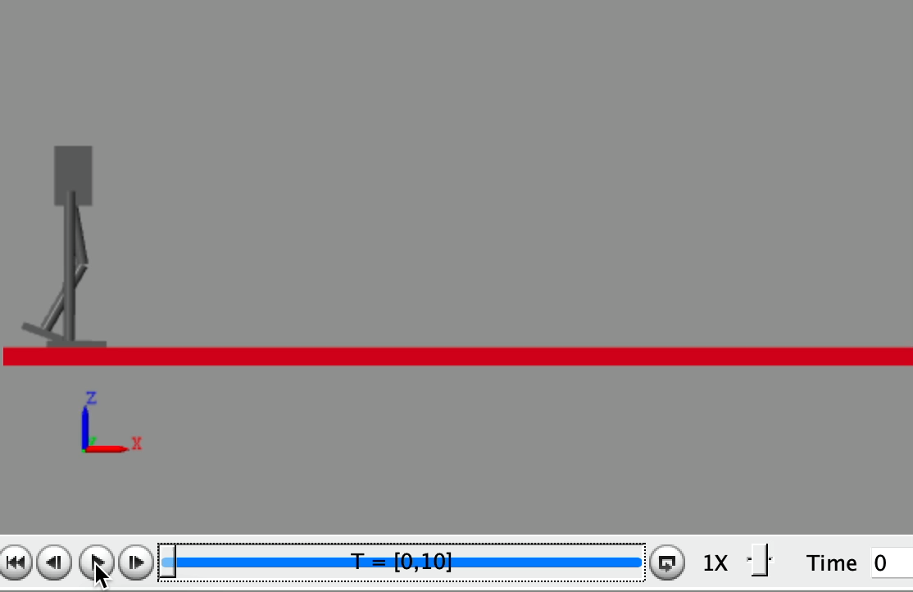
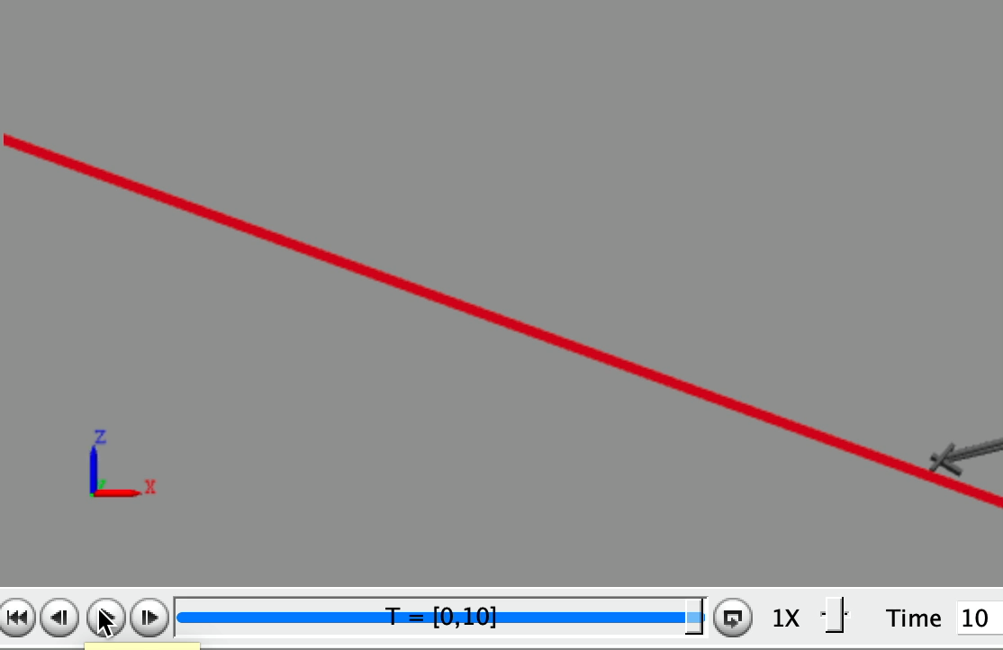
Dynamic Stability: Failed Simulations in SimScape
No No-slip condition: Plane and Inclined Plane

Slide 12
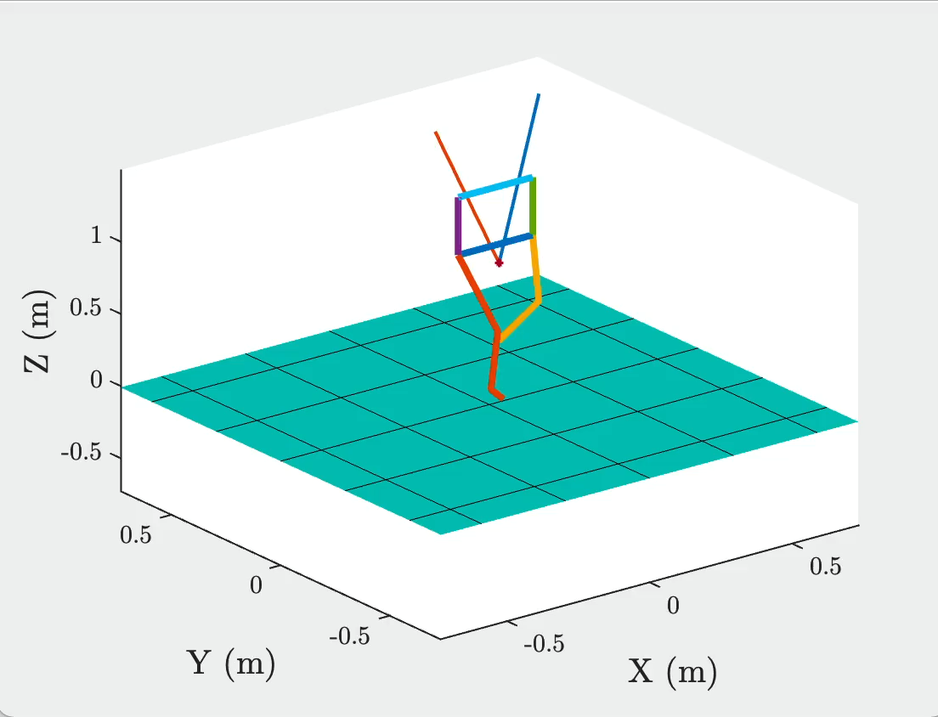
Dynamic Stability: Results-Stance stability
Simulation results: Animation and CG motion for stance stability
Simulation Video
CG position with time
CG position: small change under continuous variable disturbance (10 seconds)

Slide 13
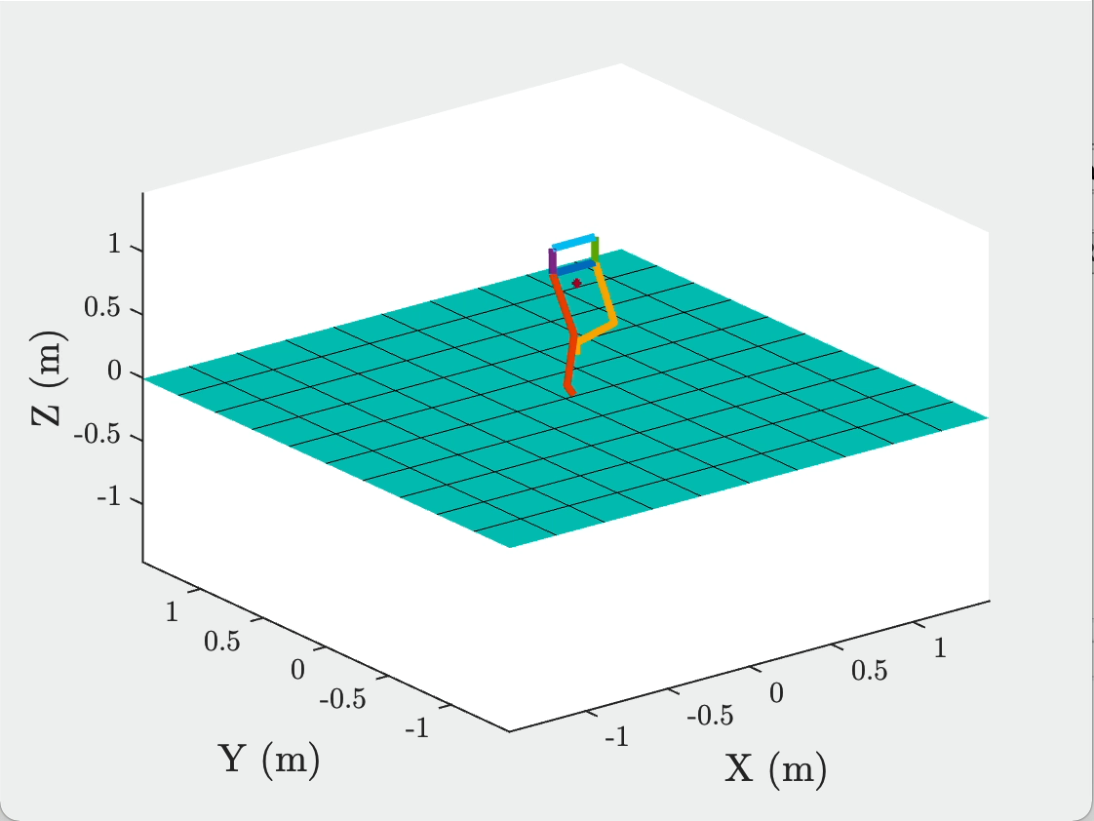

Dynamic Stability: Results
Simulation results for disturbance during trajectory: Animation
Simulation Video (Normal Trajectory)
Simulation Video (Trajectory after
disturbance)

Slide 14
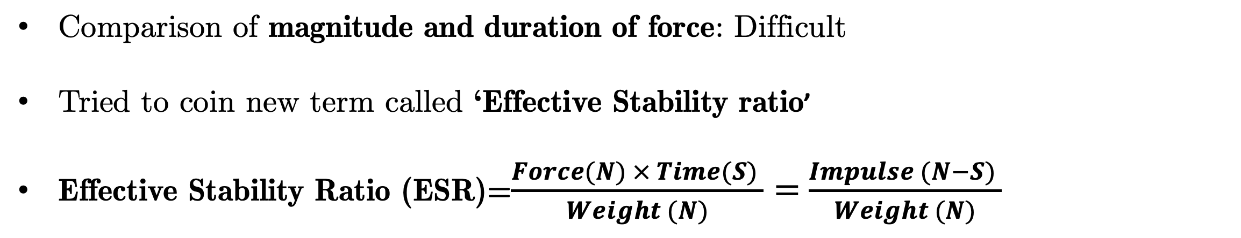
Dynamic Stability: Results Comparison
Comparison of magnitude and duration of force: Difficult
Tried to coin new term called ‘Effective Stability ratio’
Effective Stability Ratio (ESR)=$\frac{Force(N) × Time(S) }{Weight (N)}=$ $\frac{Impulse (N−S) }{Weight (N)}$
Work | Stability Check | ESR
Orin et al. (2013) | Stance Stability | 0.02
Bhaskar et al. (2021) | Stability during Trajectory | 0.01
Current Work 1 | Stance Stability | 0.5
Current Work 2 | Stability during Trajectory | 0.025
Contribution: Stability against external disturbance for better Effective Stability ratio
Orin, David E., Ambarish Goswami, and Sung-Hee Lee. "Centroidal dynamics of a humanoid robot." Autonomous robots 35.2 (2013): 161-176
Bhaskar, Amisha, et al. "Adaptive Artificial Time Delay Control for Bipedal Walking with Robustification to State-dependent Constraint Forces." 2021 20th International Conference on Advanced Robotics (ICAR). IEEE, 2021.

Slide 15
Dynamic Stability: Quadruped
Quadruped: Kinematic Architecture

Slide 16
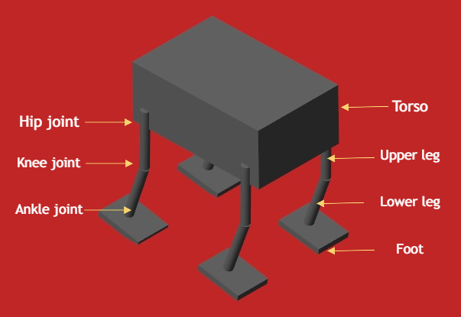
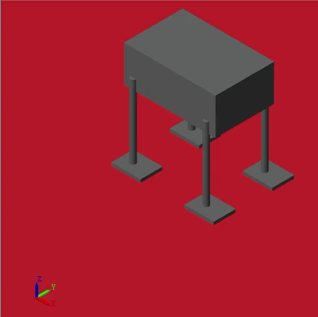
Dynamic Stability: Quadruped
Objective: Stability of Quadruped robot under external disturbance
Quadruped Modelling in Simulink
Quadruped animation under continuous disturbance
Problem: Quadruped sliding because of continuous push
Reason: No-Slip condition not provided

Slide 17
Dynamic Stability: Quadruped
Introduction of Non-linear optimization as shown for biped earlier
Including no slip condition
Utilized fmincon in MATLAB with ‘sqp’ algorithm
Ran simulation for various Effective Stability Ratios. i.e. Impulse/weight of robot
Modifications in strategy

Slide 18
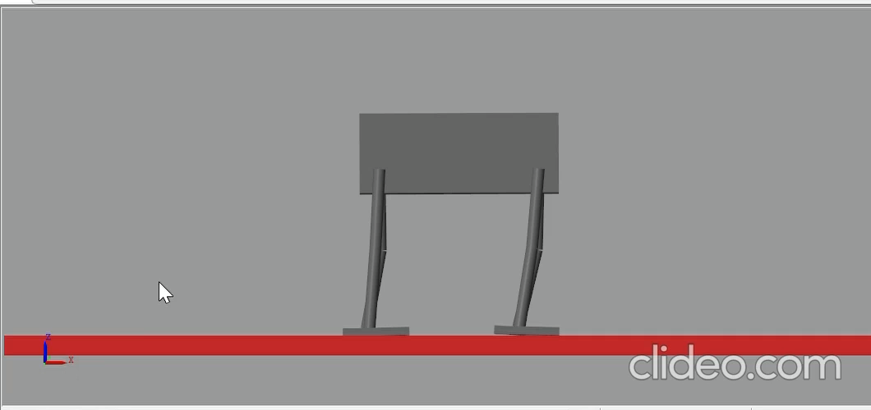
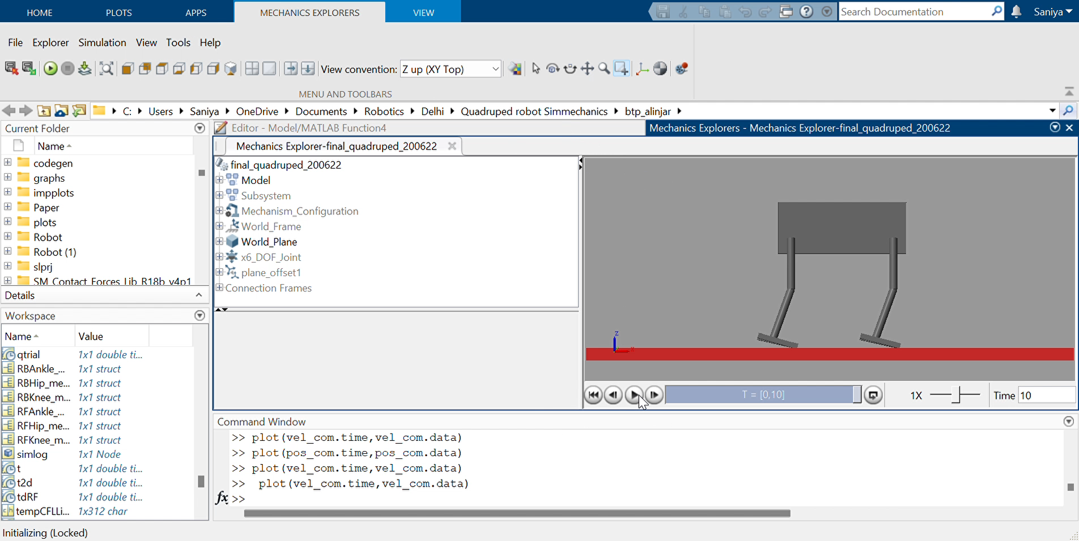
Dynamic Stability: Quadruped Results
Force=20N, Impact time=0.2s,
Weight=4.12kg
Force=1N, Impact time=10s, Weight=4.12kg
ESR=0.27
ESR=0.098
Problem for First case (High ESR): Simulation becomes too slow for execution after t=0.668 S due to optimization (Suggestions Please), Hence presented for that time period

Slide 19
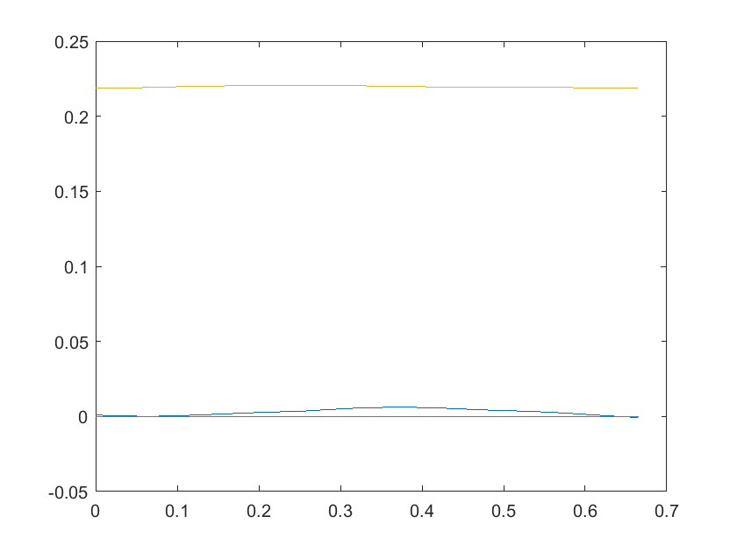
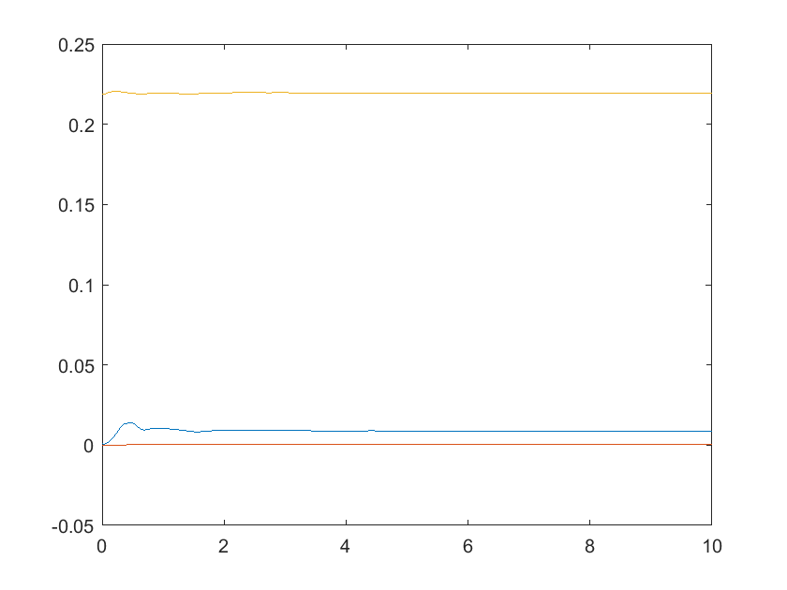
Dynamic Stability: Quadruped Results
Results- Centre of Mass (COM) displacement
ESR=0.27
ESR=0.098
COM_{x}
COM_{y}
COM_{z}
COM_{x}
COM_{y}
COM_{z}
COM Position (m)
Time (S)
Time (S)
COM position change minimal despite movement of the Quadruped: Aim fulfilled

Slide 20
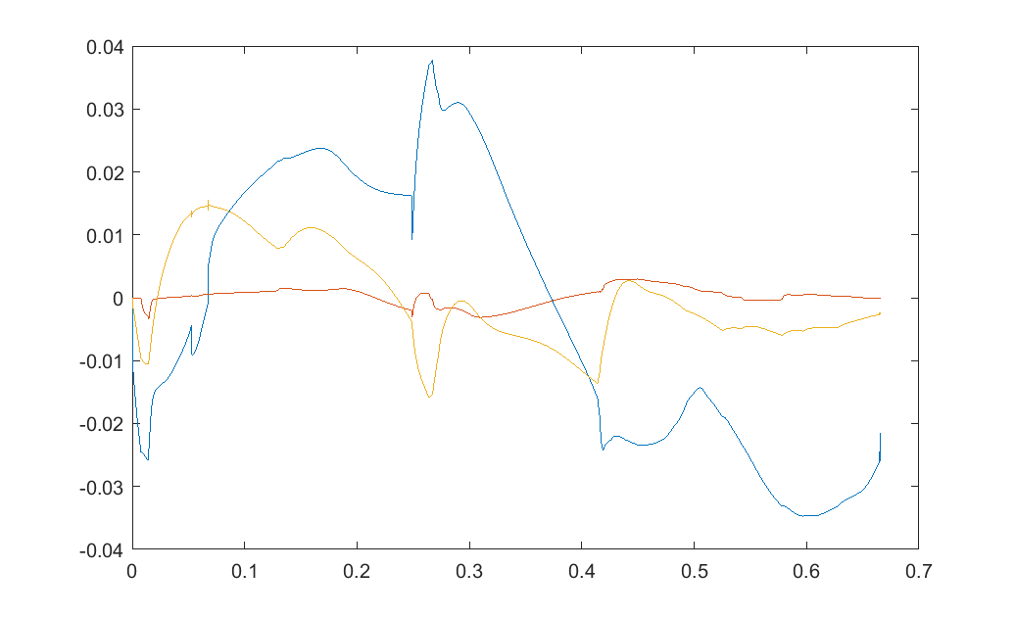
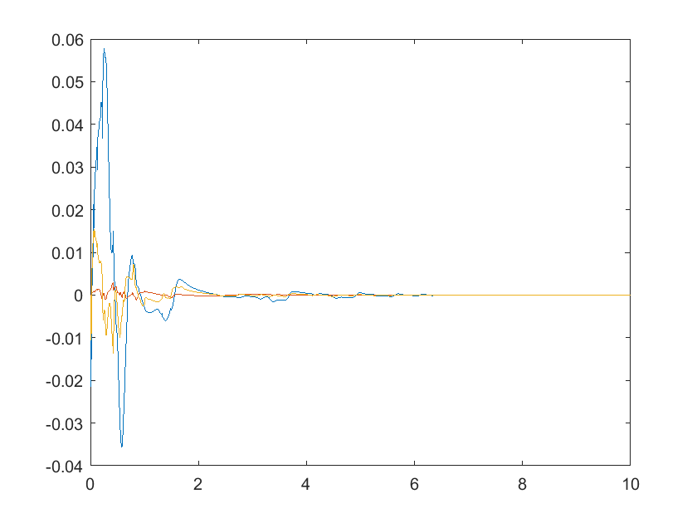
Dynamic Stability: Quadruped Results
Results- Centre of Mass (COM) displacement
ESR=0.27
ESR=0.098
COM_{x}
COM_{y}
COM_{z}
COM_{x}
COM_{y}
COM_{z}
COM velocity (m/s)
Time (S)
Time (S)
COM velocity: kind of damped response for left figure

Slide 21
Conclusions, and Future work
Conclusion
Proposed a control methodology to obtain dynamic stability of biped and Quadruped under continuous and variable external disturbance (force and moment) with better Impulse/Weight ratio (ESR).
Future work
Overcoming the optimization problem
Improving ESR
Stability at uneven surfaces
Validation of the above works in Pybullet (in progress)
Hardware validation of the proposed methodology

Slide 22
Thank you for your kind attention

Slide 23
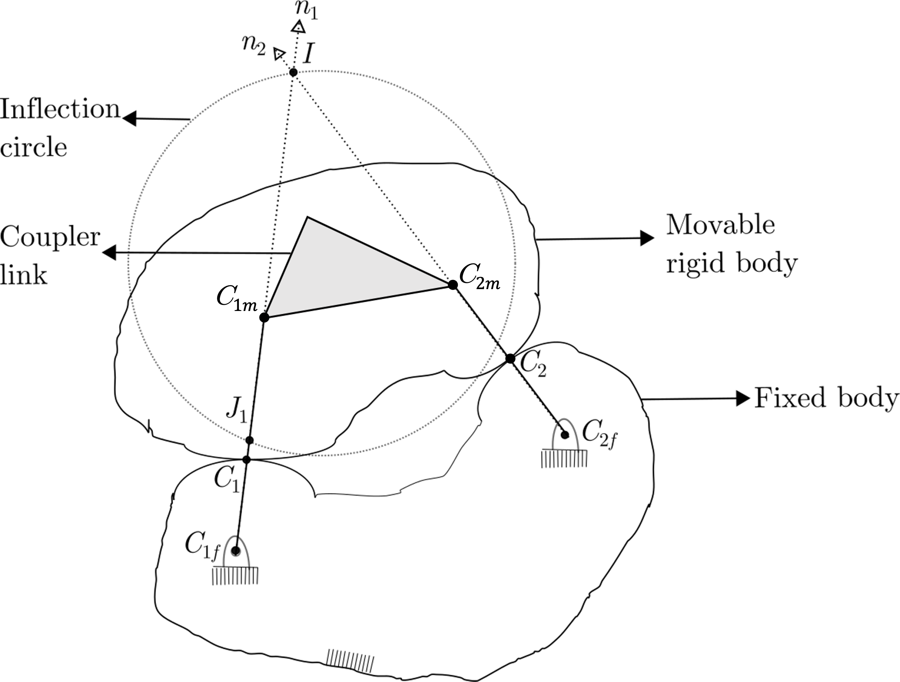
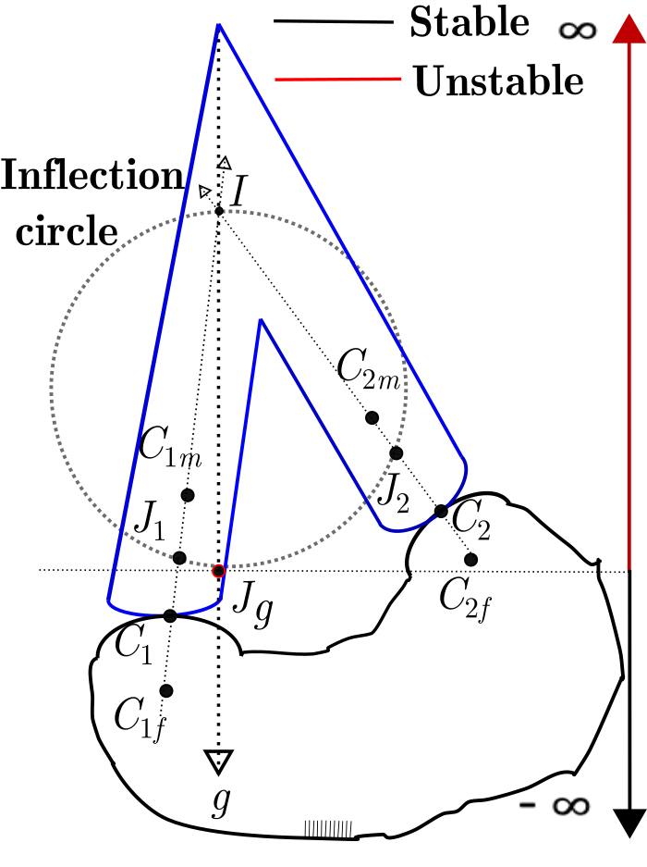


Static Stability: Calculation behind Curvature theory
Euler-Savary equation
$$\frac{1}{IC_{1m}}−\frac{1}{IC_{1f}}=\frac{1}{IJ_{1}}$$
$$\frac{1}{IC_{2m}}−\frac{1}{IC_{2f}}=\frac{1}{IJ_{2}}$$
Equivalence of four bar mechanism to a rigid body :
held by two contacts
Stability region for double contact
Dijksman, E. A., 1976, Motion Geometry of Mechanisms CUP Archiv
Hartenberg, R., and Danavit, J., 1964, Kinematic Synthesis of Linkages New York: McGraw-Hill.

Slide 24
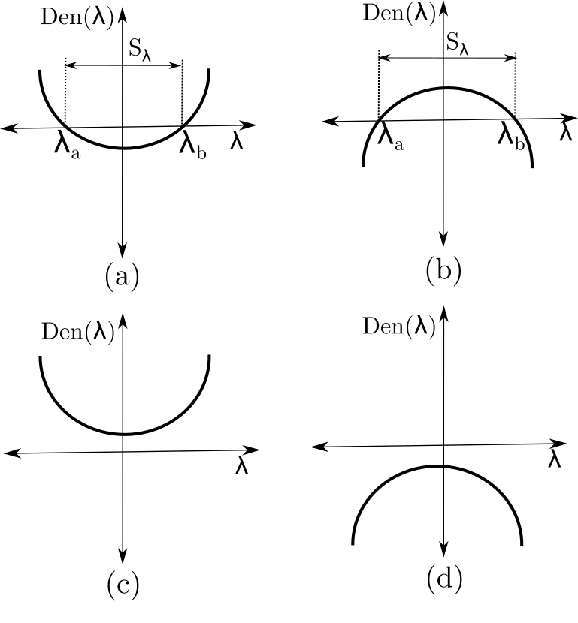
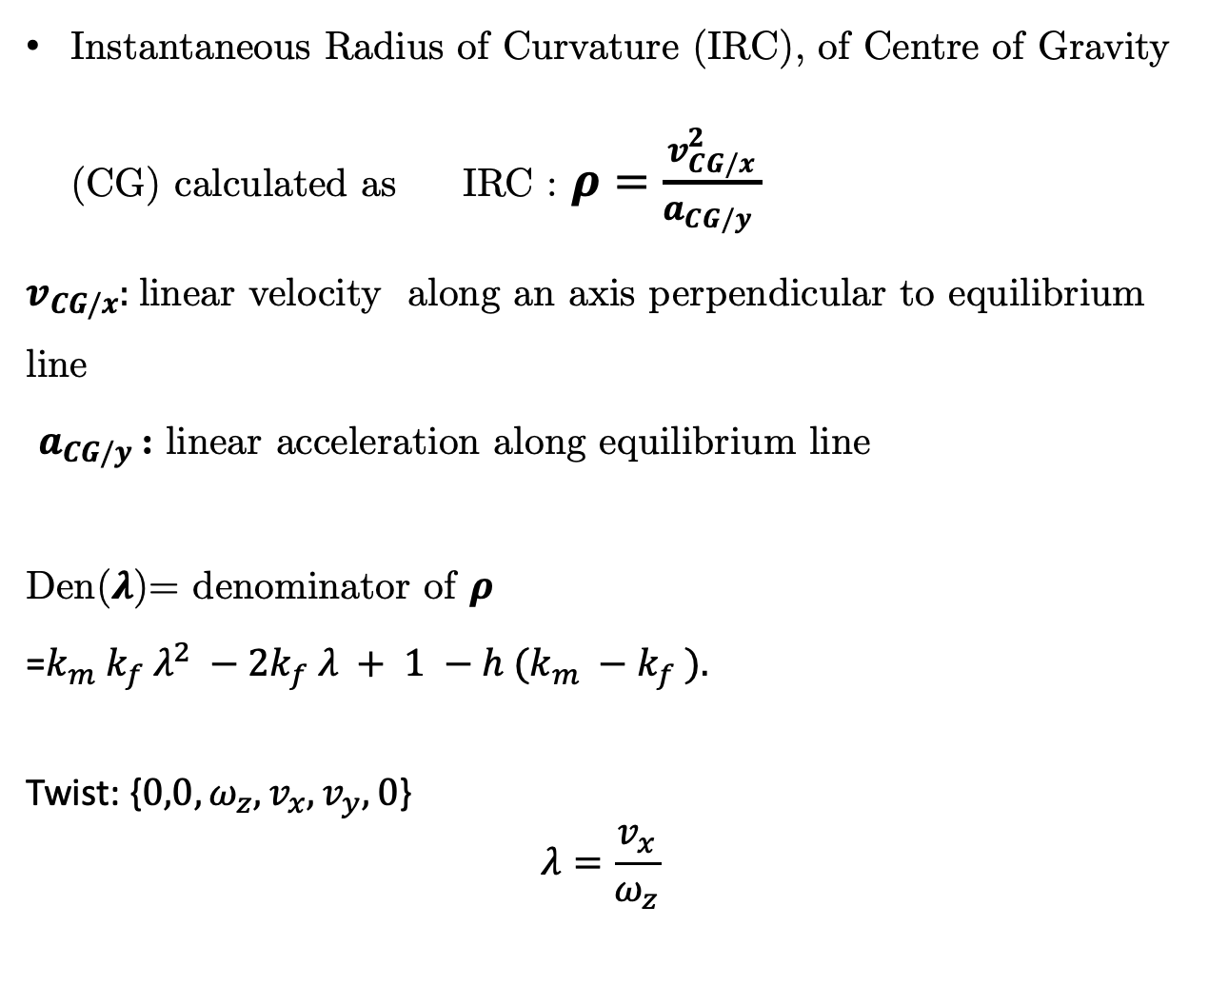
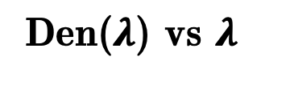
Static Stability: Calculation behind stability of single contact system
Instantaneous Radius of Curvature (IRC), of Centre of Gravity (CG) calculated as IRC : $ρ=\frac{v_{CG/x}^{2}}{a_{CG/y} }$
$v_{CG/x}:$linear velocity along an axis perpendicular to equilibrium line
$a_{CG/y}$: linear acceleration along equilibrium line
Den($λ$)= denominator of $ρ$
=$k_{m} k_{f} λ^{2} −2k_{f} λ + 1 −h (k_{m} −k_{f} ).$
Twist: {$0,0,ω_{z},v_{x},v_{y},0$}
$$λ=\frac{v_{x}}{ω_{z}}$$
Den($λ$) vs $λ$

Slide 25
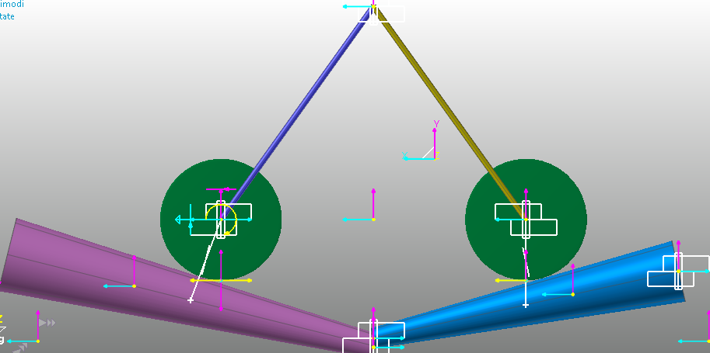
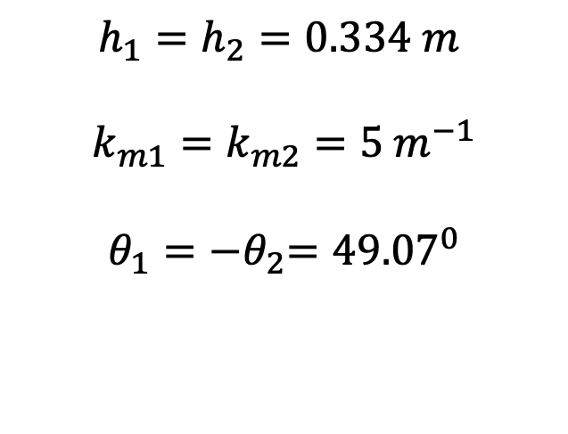
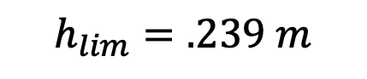



Static Stability: Calculation behind simulation
$$h_{1}=h_{2}=0.334 m$$
$$k_{m1}=k_{m2}=5 m^{−1}$$
$$θ_{1}={−θ}_{2}={49.07}^{0}$$
$$h_{lim}$$
$$h_{1}$$
$$h_{2}$$
$$h_{lim}=.239 m$$
Stability
Static stability of two contact system

Slide 26
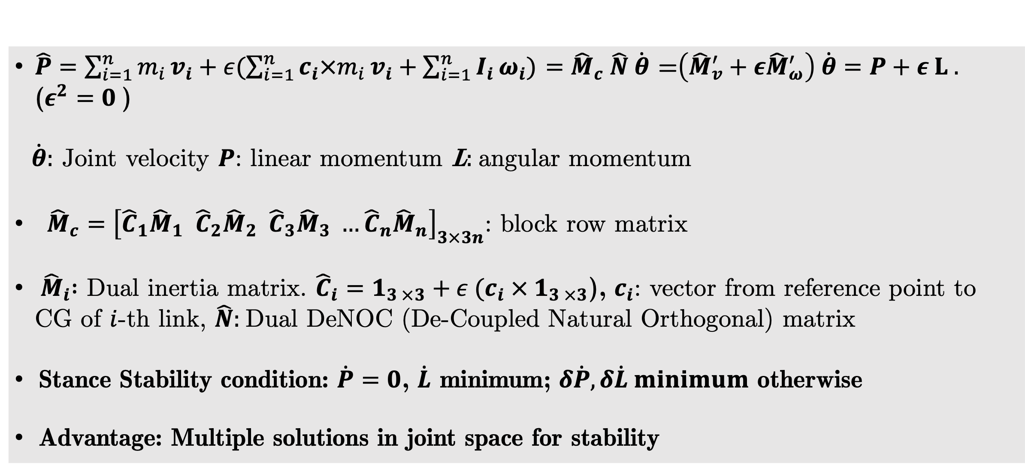
Dynamic Stability: Centroidal Dynamics
Introducing Dual Algebra to derive Principal Centroidal momentum: utilized in control
(Motivation: Bandyopadhyay et al. 2004)
Dual Centroidal Momentum
$\hat{P}=\sum_{i=1}^{n}{m_{i}}v_{i}+ε(\sum_{i=1}^{n}{{c_{i}×m}_{i}}v_{i}+\sum_{i=1}^{n}{I_{i}}ω_{i})$ $={\hat{M}}_{c} \hat{N} \dot{θ}$ =$\left({\hat{M}}_{v}^{′}+ε{\hat{M}}_{ω}^{′}\right) \dot{θ}=P+ε L .$ ($ε^{2}=0$)
$\dot{θ}:$ Joint velocity $P$: linear momentum L$:$angular momentum
${\hat{M}}_{c}={\left[{\hat{C}}_{1}{\hat{M}}_{1}{{ \hat{C}}_{2}\hat{M}}_{2}{{ \hat{C}}_{3}\hat{M}}_{3} …{{\hat{C}}_{n}\hat{M}}_{n}\right]}_{3×3n}$: block row matrix
${ \hat{M}}_{i} :$ Dual inertia matrix. ${\hat{C}}_{i}=1_{3 ×3}+ε {(c}_{i} × 1_{3 ×3}$), $c_{i}$: vector from reference point to CG of $i$-th link, $\hat{N}:$Dual DeNOC (De-Coupled Natural Orthogonal) matrix
Stance Stability condition: $\dot{P}=0$, $\dot{L}$ minimum; $δ\dot{P},δ\dot{L} minimum$ otherwise
Advantage: Multiple solutions in joint space for stability
Bandyopadhyay, Sandipan, and Ashitava Ghosal. "Analytical determination of principal twists in serial, parallel and hybrid manipulators using dual vectors and matrices." Mechanism and Machine Theory 39.12 (2004): 1289-1305.s

Slide 27

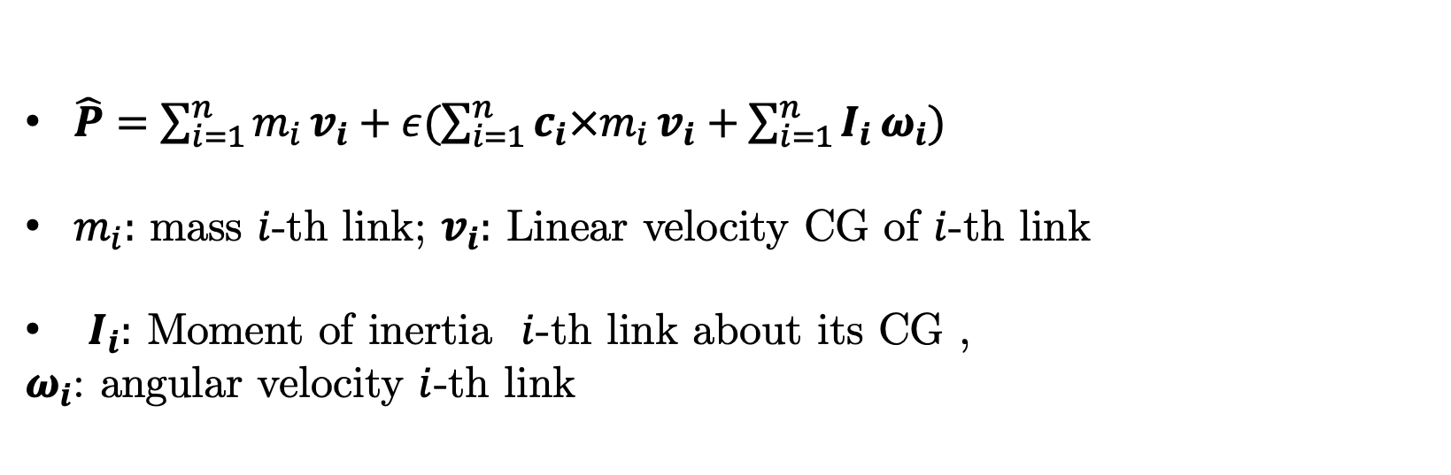
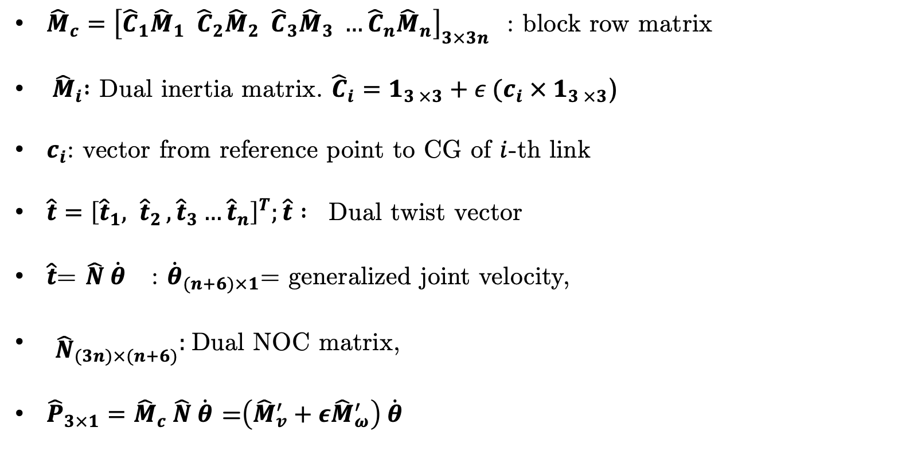
Centroidal Dynamics
$\hat{P}=\sum_{i=1}^{n}{m_{i}}v_{i}+ε(\sum_{i=1}^{n}{{c_{i}×m}_{i}}v_{i}+\sum_{i=1}^{n}{I_{i}}ω_{i})$
$m_{i}:$ mass $i$-th link; $v_{i}:$ Linear velocity CG of $i$-th link
$I_{i}:$ Moment of inertia $i$-th link about its CG ,
$ω_{i}$: angular velocity $i$-th link
Angular momentum
Centre of gravity
Linear
momentum
Dual Momentum $\hat{P}={\hat{M}}_{c} \hat{t}$
${\hat{M}}_{c}={\left[{\hat{C}}_{1}{\hat{M}}_{1}{{ \hat{C}}_{2}\hat{M}}_{2}{{ \hat{C}}_{3}\hat{M}}_{3} …{{\hat{C}}_{n}\hat{M}}_{n}\right]}_{3×3n}$ : block row matrix
${ \hat{M}}_{i} :$ Dual inertia matrix. ${\hat{C}}_{i}=1_{3 ×3}+ε {(c}_{i} × 1_{3 ×3}$)
$c_{i}$: vector from reference point to CG of $i$-th link
$\hat{t}={\left[{\hat{t}}_{1}{, \hat{t}}_{2},{\hat{t}}_{3}…{\hat{t}}_{n}\right]}^{T};\hat{t} : \text{Dual} \text{twist} \text{vector}$
$\hat{t}$= $\hat{N} \dot{θ}$ : ${\dot{θ}}_{(n+6)×1}$= generalized joint velocity,
${\begin{aligned} \\ \hat{N}\end{aligned}}_{(3n)×(n+6)}:$Dual NOC matrix,
${\hat{P}}_{3×1}={\hat{M}}_{c} \hat{N} \dot{θ}$ =$\left({\hat{M}}_{v}^{′}+ε{\hat{M}}_{ω}^{′}\right) \dot{θ}$
A biped model in Sim-Mechanics

Slide 28
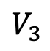
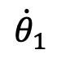
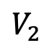
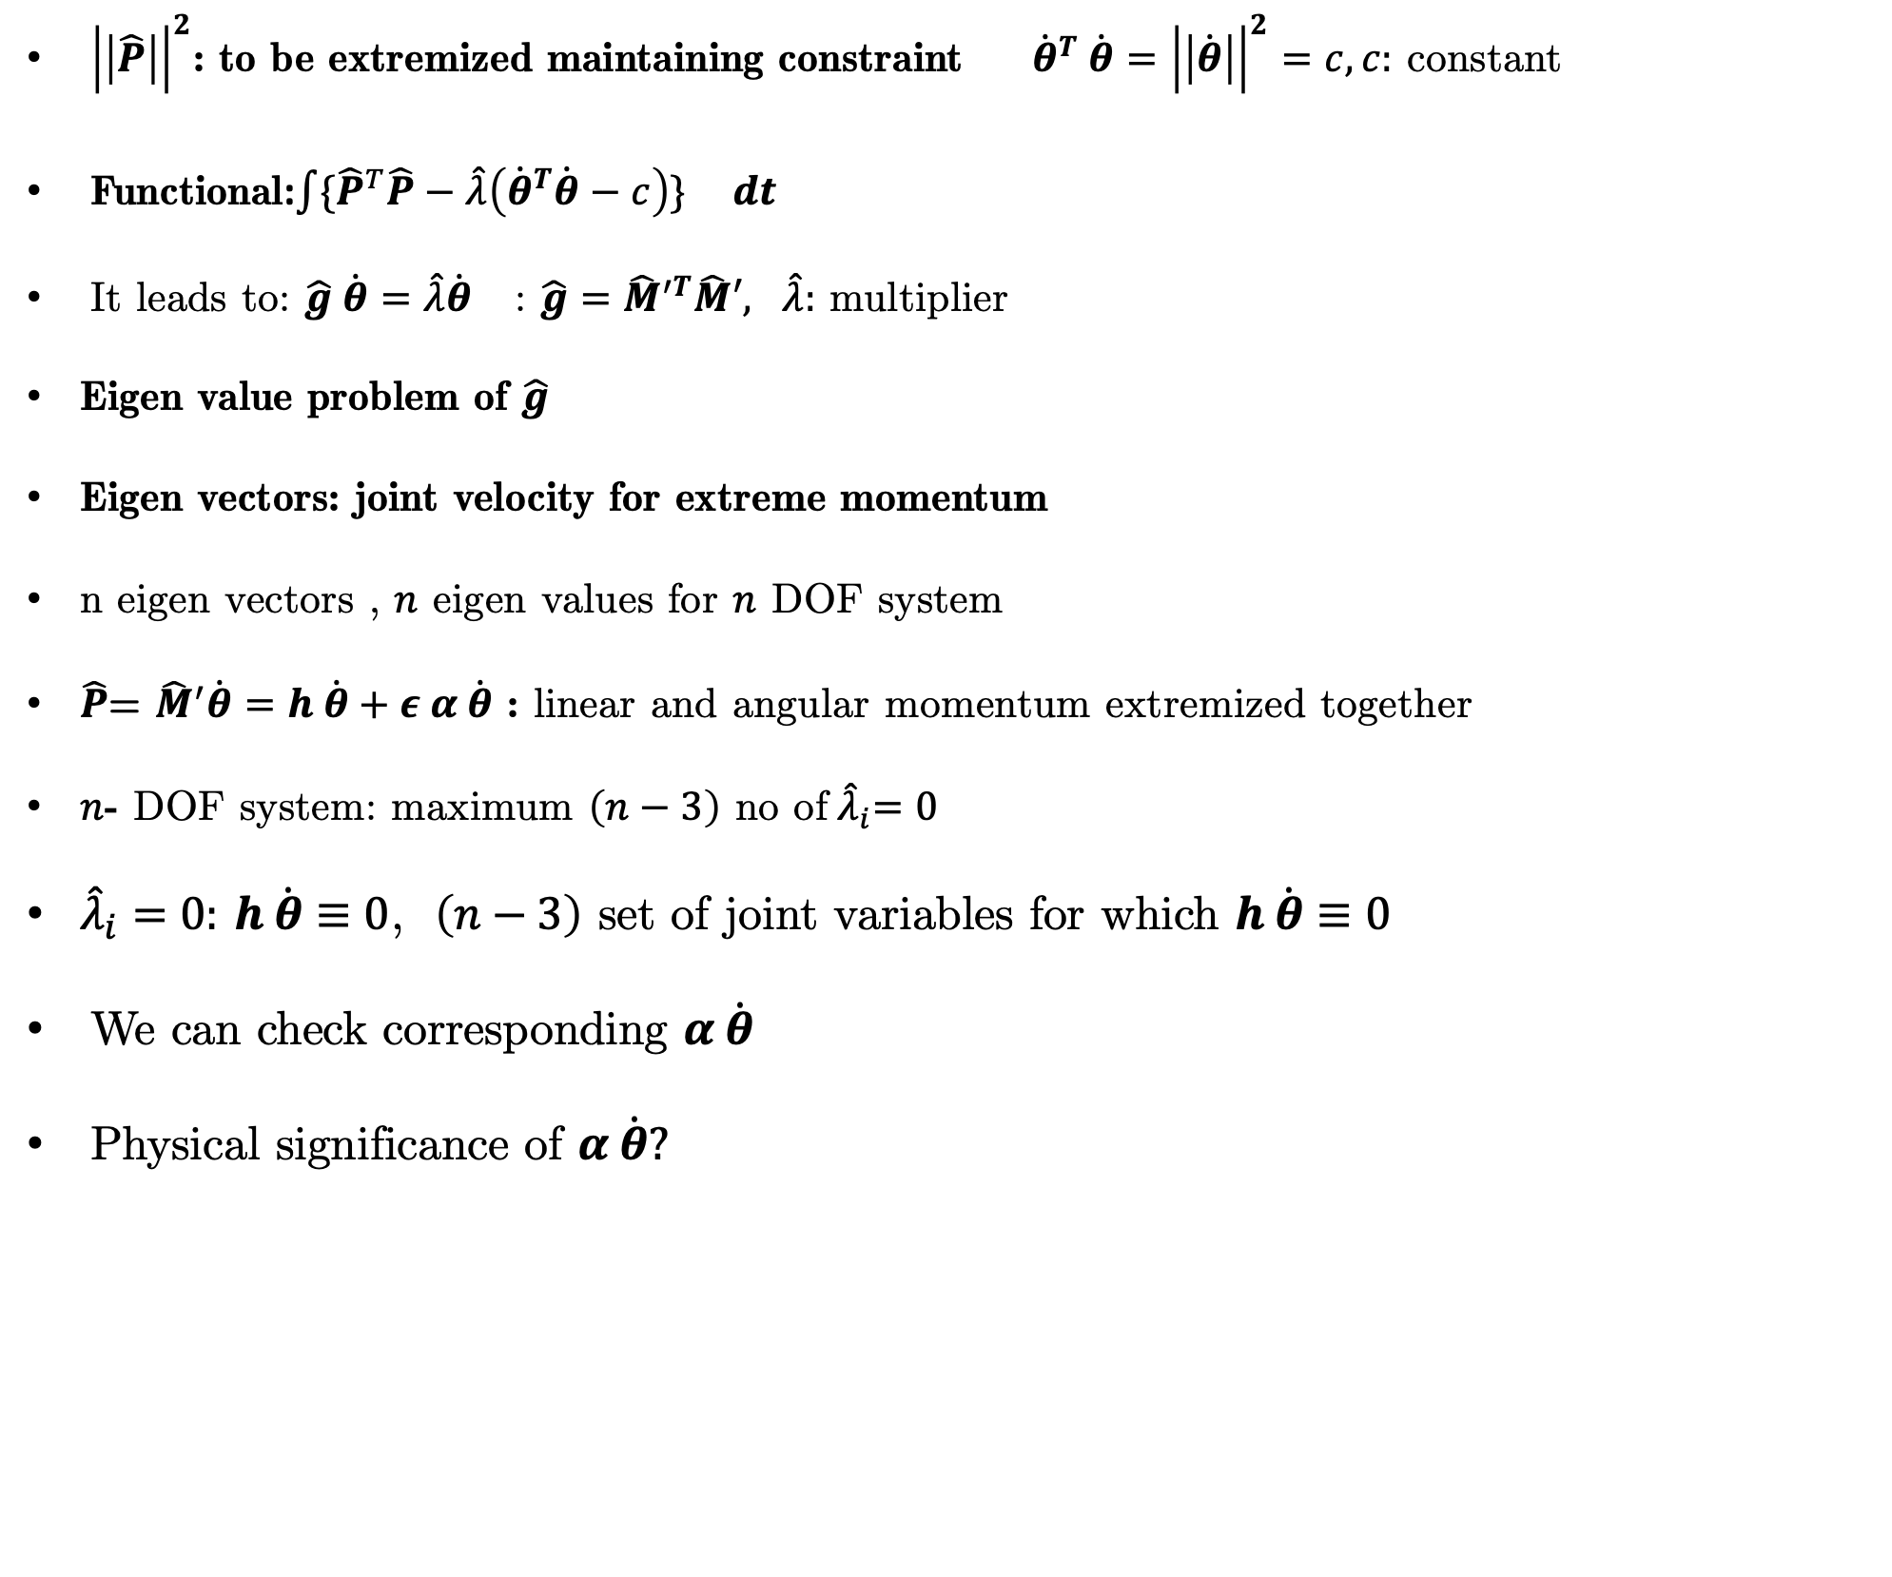
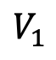



Centroidal Dynamics
${\left|\left|\hat{P}\right|\right|}^{2}$: to be extremized maintaining constraint ${ \dot{θ}}^{T} \dot{θ}={\left|\left|\dot{θ}\right|\right|}^{2}=c, c:$ constant
Functional:${\int{{\{\hat{P}}^{T}\hat{P}−\hat{λ}\left({\dot{θ}}^{T}\dot{θ}−c\right)\}}}^{} dt$
It leads to: $\hat{g} \dot{θ}=\hat{λ}\dot{θ}$ : $\hat{g}={\hat{M}}^{′T}\hat{M}′, \hat{λ}:$ multiplier
Eigen value problem of $\hat{g}$
Eigen vectors: joint velocity for extreme momentum
n eigen vectors , $n$ eigen values for $n$ DOF system
$\hat{P}$= ${\hat{M}}^{′}\dot{θ}=h \dot{θ}+ε α \dot{θ}$ : linear and angular momentum extremized together
$n$- DOF system: maximum $\left(n−3\right)$ no of${ \hat{λ}}_{i}=0$
${\hat{λ}}_{i}=0:$ $h \dot{θ}≡0$, $\left(n−3\right)$ set of joint variables for which $h \dot{θ}≡0$
We can check corresponding $α \dot{θ}$
Physical significance of $α \dot{θ}?$
$V_{i}:$Eigen vectors
h $(V_{1})$>h$\left(V_{2}\right)>$ h $(V_{3})$
$${\dot{θ}}_{2}$$
$$V_{1}$$
$$V_{3}$$
$${\dot{θ}}_{1}$$
$${\dot{θ}}_{3}$$
$$V_{2}$$
Simple example on choosing set of joint velocity

Slide 29
Relationship bet. Human Joint Motions and biped model motion
https://www.physio-pedia.com/Range_of_Motion
https://design.tutsplus.com/articles/human-anatomy-fundamentals-flexibility-and-joint-limitations--vector-25401
Hip 3
Joint Axis name | Motion name | Joint Limit (Degree) | Motion name | Joint Limit (Degree)
Ankle 1 | Plantar Flexion (Flexion) | 40/45 | Dorsi Flexion (Extension) | 25/30
Ankle 2 | Pronation (Inversion) | 23/30 | Supernation (Eversion) | 12/10
Knee | Flexion | 130/150 | Extension (Hyper-Extension) | 0/(-15)
Hip 1 | Flexion | 100/110 | Extension (Hyper-Extension) | 0/(-30)
Hip 2 | Abduction | 30/40 | Adduction | 20
Hip 3 | External Rotation | 45/50 | Internal Rotation | 40
Hip 2
Hip 1
Knee
Ankle 1
Ankle 2

Slide 30

Centroidal Dynamics: Equation of Motion
Hip 3
$\dot{L}−\left(c−p\right) × \left(\dot{P}−Mg\right)=0$; c=CG; p =Zero Moment point(ZMP);
$P≡$ Linear momentum, $L≡$ Angular momentum
M=$∑m_{i} , g≡$gravity
Hip 2
Hip 1
Knee
Ankle 1
Ankle 2
Impulse/Weight(Orin et al. 2013)=120N*1s/(50*9.81N)=0.2445s
Impulse/Weight(Current work)=10N*10s/(5*9.81N)=2.03s

Slide 31



Theory behind Control
Computed torque Control:
$τ=I \overline{a}+ φ, \overline{a}={\ddot{θ}}_{d}+k_{p}e+k_{v} \dot{e}$
For this problem, PID can also be applied
$$P=h\left(θ\right) \dot{θ}$$
$L=α\left(θ\right)\dot{θ}$
Optimization: SQP(Sequential Quadratic Programming used)
Variable W
Objective function:
||$I\left({\ddot{θ}}_{d}+k_{v}\left({\dot{θ}}_{d}−{\dot{θ}}_{}\right)\right)+φ|{{\left.​\right|}^{2}}_{2}+{{\left|\left|α VW\right|\right|}^{2}}_{2}$ where${ \dot{θ}}_{d}=VW$ and ${\ddot{θ}}_{d}=A{\dot{θ}}_{d};$
$A=f\left(h,α\right), V=$eigen vector of $h^{T}h$
Subject to
$C\left(h \ddot{θ}+hVW+Mg\right)<μN$; $Mg≡$Weight $μ$Friction coefficient $N$: normal force;
$C≡2×3$matrix extracting forces acting along the plane
$B(h \ddot{θ}+hVW+Mg$)>0; $B≡1×3$matrix extracting normal force on the plane
Impulse/Weight(Orin et al. 2013)=120N*1s/(50*9.81N)=0.2445s
Impulse/Weight(Current work)=10N*10s/(5*9.81N)=2.03s

Slide 32
Dynamic Stability : Results for disturbance during trajectory
Simulation results for disturbance during trajectory : Joint rate and Joint torque
Joint rates with time
Joint torques with time
Rapid change in the joint rate of Left Ankle2 during disturbance

Slide 33
Dynamic Stability: Results
Simulation results for disturbance during trajectory: CG motion
CG position with time
CG almost follows trajectory with an error of the order 1e-3 upon disturbance

Slide 34
Disturbed and Normal Trajectory: Torque Comparison

Slide 35
Disturbed and Normal Trajectory: Joint rate Comparison

Slide 36

Disturbance at other time

Slide 37
Biped fall and slip
Biped fall and Slip
Biped fall under gravity and external disturbance:
no controller applied
Biped slips upon disturbance: friction condition not included

Slide 38
Biped Rotation
Biped Rotation
Biped rotates upon disturbance: Angular momentum condition not included

Slide 39


Contact Modelling
Contact modelling
Analytical
Impulse
Penalty based
Penalty based method:
Normal force
$F_{z}=kz+c\left(δ\right)\overset{˙}{z};$
$k:$spring constant $c$ : damping coefficient $δ$:Penetration
$k=k^{′}$ and $c=c^{′}$, if $v_{\text{foot} }<0$
$k=k^{′}$ and $c=a_{0}+a_{1}δ+a_{2}δ^{2}+a_{3}δ^{3}$, if $v_{\text{foot} }>0$
$c^{′}=2ς\sqrt{k^{′}∑_{i=0}^{n} m_{i}}$ $ς :$ Critical damping coeff. $m_{i}$: $i$th link mass
Friction Force
$F_{x}=−\left(μF_{z}\right)\frac{2}{π}\tan^{−1}⁡\left(\frac{c_{x}\overset{˙}{x}}{μF_{z}}\frac{π}{2}\right)$, $F_{y}=−\left(μF_{z}\right)\frac{2}{π}\tan^{−1}\left(\frac{c_{y}\overset{˙}{y}}{μF_{z}}\frac{π}{2}\right)$
$μ:$ Friction coefficient, $c_{x}, c_{y}$: Damping coeffs for $x,y$ respectively
Penalty based Visco-Elastic model
Shah, Suril Vijaykumar, Subir Kumar Saha, and Jayanta Kumar Dutt. "Dynamics of tree-type robotic systems." Dynamics of tree-type robotic systems. Springer, Dordrecht, 2013. 73-88.

Slide 40

Quadruped Simulation: Simulink

Slide 41



Energy Balance: Normal Trajectory
Work done by actuator
Actuator Energy $=∫\left(∑_{k=1}^{η} τ_{k}{\overset{˙}{θ}}_{k}\right)dt$
Energy dissipation by ground $=$
Ground Energy=
$$∫\left(∑_{k=1}^{η} f_{k}^{T}v_{k}\right)dt$$
Kinetic Energy KE Potential Energy PE
$$\begin{matrix}KE & =\frac{1}{2}∑_{k=1}^{η} \left(m_{k}{\overset{˙}{c}}_{k}^{T}{\overset{˙}{c}}_{k}+ω_{k}^{T}I_{k}ω_{k}\right) \\ PE & =∑_{k=1}^{η} m_{k}g_{k}^{T}c_{k}\end{matrix}$$

Slide 42

Pybullet Model: Biped

